Slide 1


Slide 2

PRESENTED TO
Md Ifthekar Parvez
Assistant Professor
Department of Statistics

Slide 3
PRESENTED TO
Md Ifthekar Parvez
Assistant Professor
Department of Statistics

Slide 4

Ittehad
Tasdik
Anayet
Ferdouci
Nuzhat
Emu

Slide 5
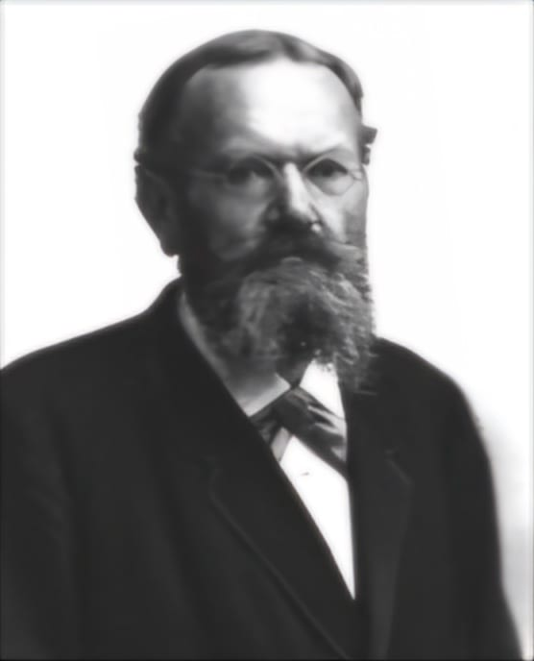



Routine
Shopping List
Educational Contexts
When you create a shopping list, you are forming a set of items you need to buy. Checking off items as you find them in the store is akin to subtracting elements from this set.
Your daily tasks form a set of activities that need to be completed. Prioritizing tasks can be seen as organizing subsets based on importance.
Students can be grouped into sets based on various criteria such as grade level, subjects they study, or extracurricular activities.
The theory of sets was developed by German mathematician Georg Cantor (1845-1918)
3
SET
He first encountered sets while working on "problems on trigonometric series".
2
THEORY
1

Slide 6
Educational Contexts
Routine
Shopping List
When you create a shopping list, you are forming a set of items you need to buy. Checking off items as you find them in the store is akin to subtracting elements from this set.
Students can be grouped into sets based on various criteria such as grade level, subjects they study, or extracurricular activities.
Your daily tasks form a set of activities that need to be completed. Prioritizing tasks can be seen as organizing subsets based on importance.
The theory of sets was developed by German mathematician Georg Cantor (1845-1918)
3
He first encountered sets while working on "problems on trigonometric series".
2
1

Slide 7
Routine
Shopping List
Educational Contexts
When you create a shopping list, you are forming a set of items you need to buy. Checking off items as you find them in the store is akin to subtracting elements from this set.
Your daily tasks form a set of activities that need to be completed. Prioritizing tasks can be seen as organizing subsets based on importance.
Students can be grouped into sets based on various criteria such as grade level, subjects they study, or extracurricular activities.
The theory of sets was developed by German mathematician ‘Georg Cantor’ (1845-1918)
3
He first encountered sets while working on "problems on trigonometric series".
2
1

Slide 8
Routine
Shopping List
Educational Contexts
When you create a shopping list, you are forming a set of items you need to buy. Checking off items as you find them in the store is akin to subtracting elements from this set.
Your daily tasks form a set of activities that need to be completed. Prioritizing tasks can be seen as organizing subsets based on importance.
Students can be grouped into sets based on various criteria such as grade level, subjects they study, or extracurricular activities.
The theory of sets was developed by German mathematician ‘Georg Cantor’ (1845-1918)
3
He first encountered sets while working on "problems on trigonometric series".
2
1

Slide 9













Slide 10
INTRODUCTION
SET
Set is a collection of well defined object.
These objects are called elements or members of the set. The symbol for element is ∈.
For example, if you define the set as all the fruit found in my refrigerator, then apple and orange would be elements or members of that set.
Sets are usually denoted by capital letters A, B, S, etc.
Sets are usually denoted by capital letters A, B, S, etc. The elements of a set are usually denoted by small letters a, b, t, u, etc.
Examples:
A={a, b, d, 2, 4}
B=(math, religion, literature, computer science)
C= {R, P, T, ξ}
List method
Roster method
This method involves writing the members of a set as a list, separated by commas and enclosed within curly brackets.
The method of defining a set is called roster method if it is described by a statement or rule.
• For example, M = {x | xe is a month of the year
and x starts with the letter J}
For example, {Summer, Autumn, Spring, Winter}.

Slide 11
INTRODUCTION
SET
Set is a collection of well defined object.
These objects are called elements or members of the set. The symbol for element is ∈.
For example, if you define the set as all the fruit found in my refrigerator, then apple and orange would be elements or members of that set.
Sets are usually denoted by capital letters A, B, S, etc.
Sets are usually denoted by capital letters A, B, S, etc. The elements of a set are usually denoted by small letters a, b, t, u, etc.
Examples:
A={a, b, d, 2, 4}
B=(math, religion, literature, computer science)
C= {R, P, T, ξ}
List method
Roster method
This method involves writing the members of a set as a list, separated by commas and enclosed within curly brackets.
The method of defining a set is called roster method if it is described by a statement or rule.
• For example, M = {x | xe is a month of the year
and x starts with the letter J}
For example, {Summer, Autumn, Spring, Winter}.

Slide 12
Types
of
Set
Finite set
Infinite set
Finite sets are sets with a finite or countable number of elements.
Infinite sets are sets that contain either an uncountable number of elements
Example
A set of months in a year.
M = {January, February, March, April,
May, June, July, August, September,
October, November, December}
Example
The set of integers (Z) includes all positive and negative whole numbers and zero i.e.,
{ . . . -3, -2, -1, 0, 1, 2, 3, . . .}.
Subset & Superset
Proper subset
A is a subset of B if every element of A is also contains in B ( A ⊆ B) and B is the super set of A
C is a proper subset of D if every element of C is also contains in D (C ⊂ D).But C ≠ D
For example,
The set of integers {...-3, -2, -1, 0, 1, 2, 3 ...) is a
subset of the set of real numbers.
For example,
∀x (x ∈ C → x ∈ D ) ∧ ∃y (y ∈ D ∧ y ∉ C )

Slide 13
Types
of
Set
Finite set
Infinite set
Finite sets are sets with a finite or countable number of elements.
Infinite sets are sets that contain either an uncountable number of elements
Example
A set of months in a year.
M = {January, February, March, April,
May, June, July, August, September,
October, November, December}
Example
The set of integers (Z) includes all positive and negative whole numbers and zero i.e.,
{ . . . -3, -2, -1, 0, 1, 2, 3, . . .}.
Subset & Superset
Proper subset
A is a subset of B if every element of A is also contains in B ( A ⊆ B) and B is the super set of A
C is a proper subset of D if every element of C is also contains in D (C ⊂ D).But C ≠ D
For example,
The set of integers {...-3, -2, -1, 0, 1, 2, 3 ...) is a
subset of the set of real numbers.
For example,
∀x (x ∈ C → x ∈ D ) ∧ ∃y (y ∈ D ∧ y ∉ C )

Slide 14
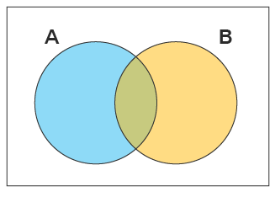
Basic
Sets
Universal Set
M.E Set
A set is called universal set if it contains all possible objects under consideration.It is denoted by U, Ω , S.
Two sets are said to be mutually exclusive if they have no common element.
Example :
If we throw a die, the universal set is the all possible
outcomes which may be written as,
Ω = (1, 2, 3, 4, 5, 6) = { x | 1≤ x ≤ 6 and x is a natural
number),
when 1, 2, 3, 4, 5 and 6 are the number of points on the
faces of the die.
Example:
if, A={1,2,3} and B={4,5,6}
then, (A ∪ B) = ∅
Empty Set
Venn Diagram
A Venn diagram is a diagram that helps us visualize the logical relationship between set and their elements
A set is called empty or null set if contains no elements.It is denoted by ∅, { }, or φ.
Example :
The set of whole numbers between 3 and 4:
{x : 3 < x < 4, x is a whole number} = ∅

Slide 15
Basic
Sets
Universal Set
M.E Set
A set is called universal set if it contains all possible objects under consideration.It is denoted by U, Ω , S.
Two sets are said to be mutually exclusive if they have no common element.
Example :
If we throw a die, the universal set is the all possible
outcomes which may be written as,
Ω = (1, 2, 3, 4, 5, 6) = { x | 1≤ x ≤ 6 and x is a natural
number),
when 1, 2, 3, 4, 5 and 6 are the number of points on the
faces of the die.
Example:
if, A={1,2,3} and B={4,5,6}
then, (A ∪ B) = ∅
Empty Set
Venn Diagram
A Venn diagram is a diagram that helps us visualize the logical relationship between set and their elements
A set is called empty or null set if contains no elements.It is denoted by ∅, { }, or φ.
Example :
The set of whole numbers between 3 and 4:
{x : 3 < x < 4, x is a whole number} = ∅

Slide 16
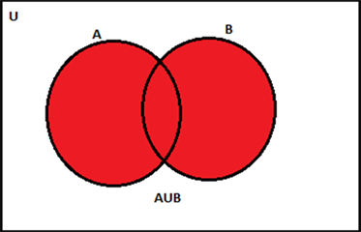
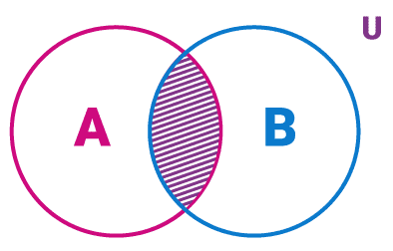
Set
Operations
Union of Set
Intersection of Set
The union of two sets (A) and (B) is defined as the set containing all elements that are present in either set (A), set (B), or both. Defined as U
The intersection of sets A and B is the set of all elements which are common to both A and B.
Defined as ∩ .
[ A ∪ B = {x : x ∈ A \text{ or } x ∈ B} ]
A ∩ B = {x : x ∈ A and x ∈ B}

Slide 17
Set
Operations
Union of Set
Intersection of Set
The union of two sets (A) and (B) is defined as the set containing all elements that are present in either set (A), set (B), or both. Defined as U
The intersection of sets A and B is the set of all elements which are common to both A and B.
Defined as ∩ .
[ A ∪ B = {x : x ∈ A \text{ or } x ∈ B} ]
A ∩ B = {x : x ∈ A and x ∈ B}

Slide 18
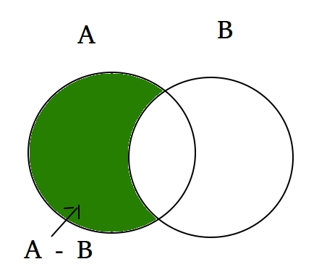
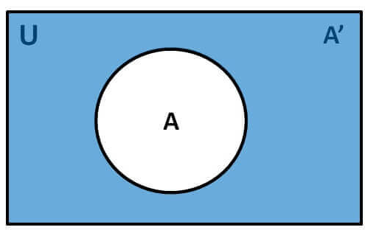
More
Set
Operations
Complementary of Set
Set Difference
if the universal set is (U) and the subset of the universal set (A) is given then the difference between universal set (U) and the subset of the universal set (A) is the complement of the subset,
The difference of two sets A and B is defined as the lists of all the elements that are in set A but that are not present in set B
Example :
A' = U - A [OR]
A' = {x ∈ U : x ∉ A}
Example :
If A = {1, 2, 3, 4} B = {2, 3, 9}
Then, A – B = {1, 4} B – A = {9}]

Slide 19
More
Set
Operations
Complementary of Set
Set Difference
if the universal set is (U) and the subset of the universal set (A) is given then the difference between universal set (U) and the subset of the universal set (A) is the complement of the subset,
The difference of two sets A and B is defined as the lists of all the elements that are in set A but that are not present in set B
Example :
A' = U - A [OR]
A' = {x ∈ U : x ∉ A}
Example :
If A = {1, 2, 3, 4} B = {2, 3, 9}
Then, A – B = {1, 4} B – A = {9}]

Slide 20
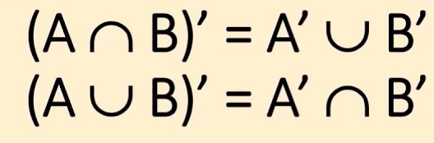
Algebra
of
Set
Commutative Laws :
A U B = B U A , A ∩ B = B ∩ A
Identity Laws
A U ∅ = A and A ∩ ∅ = ∅
A U Ω = Ω and A ∩ Ω = A
Associative Laws :
Complementary Laws
A U (B U C ) = ( A U B ) U C
A U A’ = Ω and A ∩ A’ = ∅
A ∩ ( B ∩ C ) = ( A ∩ B) ∩ C
(A ^ C) ^ C = A and U ^ C = ∅
Distributive Laws :
De morgan's law
A ∩ ( B U C ) = ( A ∩ B ) U (A ∩ C )
A U ( B ∩ C ) = ( A U B ) ∩ (A U C )
Idempotent Laws :
A U A = A and A ∩ A = A

Slide 21
Algebra
of
Set
Commutative Laws :
A U B = B U A , A ∩ B = B ∩ A
Identity Laws
A U ∅ = A and A ∩ ∅ = ∅
A U Ω = Ω and A ∩ Ω = A
Associative Laws :
Complementary Laws
A U (B U C ) = ( A U B ) U C
A U A’ = Ω and A ∩ A’ = ∅
A ∩ ( B ∩ C ) = ( A ∩ B) ∩ C
(A ^ C) ^ C = A and U ^ C = ∅
Distributive Laws :
De morgan's law
A ∩ ( B U C ) = ( A ∩ B ) U (A ∩ C )
A U ( B ∩ C ) = ( A U B ) ∩ (A U C )
Idempotent Laws :
A U A = A and A ∩ A = A

Slide 22
Conclusion
Sets are a fundamental concept in mathematics with broad applications across various fields. We've explored the basic elements of sets, operations, and Venn diagrams, which are essential tools for defining relationships and categories. Understanding sets not only lays a strong foundation in mathematics but also plays a crucial role in fields like statistics, computer science, and decision-making. As you continue your mathematical journey, remember that sets are just the beginning of a fascinating world of abstract concepts and logic. I encourage you to explore more advanced topics and discover how sets are used in solving complex real-world problems. Mathematics is a vast and ever-evolving field, and your journey has only just begun.

Slide 23


Slide 24


